Slide 1
Python, Motion Sensors and Data Fusion PyCon UK, 15 September 2016
Stephen Simmons
mail@stevesimmons.com
https://github.com/stevesimmons/pyconuk-motion-sensor-data-fusion

Slide 2
Goals for today…
Why play with motion sensors?
tiny sensors + fun applications + cheap

Slide 3
Goals for today…
Why play with motion sensors?
tiny sensors + fun applications + cheap + smart algorithms in python

Slide 4
Goals for today…
Why play with motion sensors?
tiny sensors + fun applications + cheap + smart algorithms in python
Motion sensors then and now – 1852, 1965, 2016
Example #1 – Wireless motion logging with BBC micro:bit

Slide 5
Goals for today…
Why play with motion sensors?
tiny sensors + fun applications + cheap + smart algorithms in python
Motion sensors then and now – 1852, 1965, 2016
Example #1 – Wireless motion logging with BBC micro:bit
Data fusion – combining data from multiple sensors
Example #2 – Tilt-compensating digital compass
Example #3 – 9 DoF IMU from mobile phone data

Slide 6
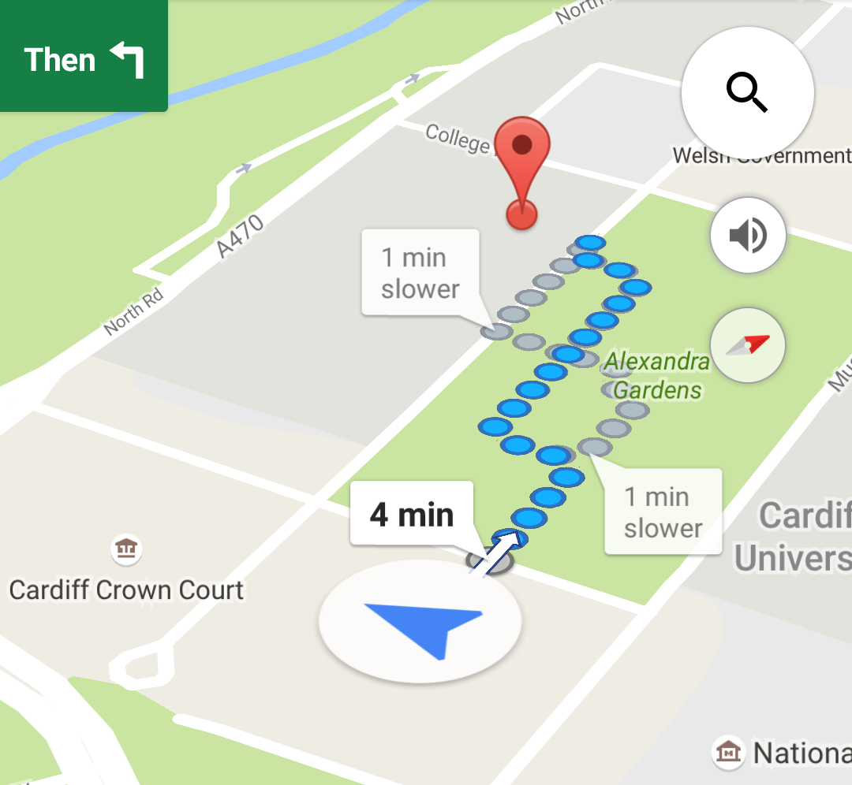
Mapping and navigation…

Slide 7
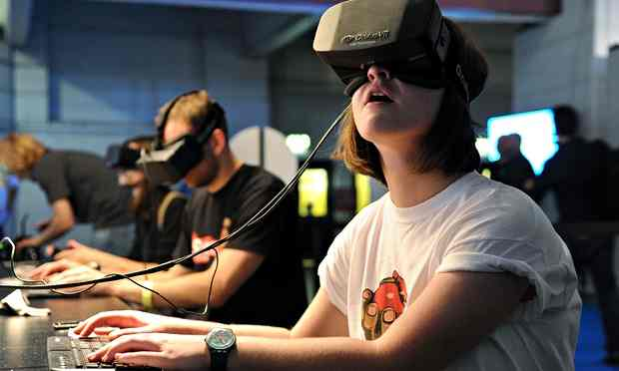
VR…
Notes:
Virtual reality – Oculus Rift photo.
Need motion sensors to track head movements accurately and with very low latency.
Otherwise you get motion sickness.

Slide 8
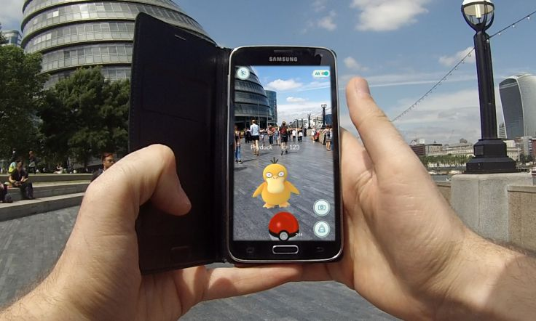
AR…
Notes:
Augmented Reality – here in Pokemon Go

Slide 9
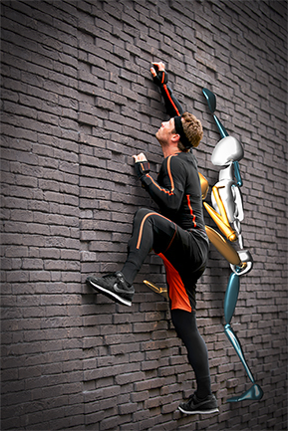
Motion capture…
Notes:
Xsens – wearing a suit with multiple sensors in key locations.
Track the user’s movements and replicate for digital animation.
https://www.xsens.com/products/xsens-mvn/

Slide 10
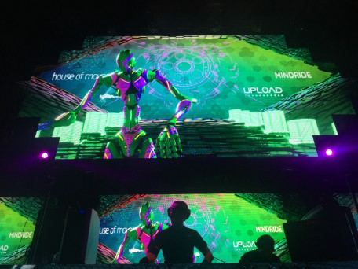
Motion capture…
Notes:
Another example of a DJ Skrillex playing in a club with life animation projected behind him.
He is wearing an Xsens MVN motion capture suit. Club is in Enschede in The Netherlands, October 2011.
https://www.xsens.com/press-releases/first-ever-live-animated-dj-performance-skrillex/

Slide 11
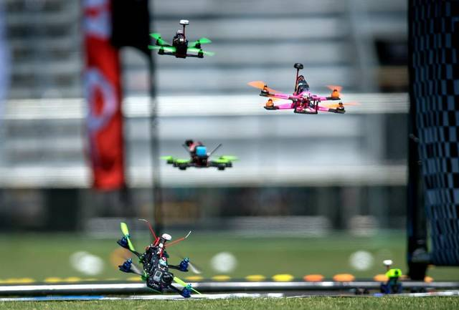
Control and stabilisation…
Notes:
Drone racing!
Challenging environment because of the vibration, electromagnetic interference from motors, etc.
Drone control projects are a good source of motion capture code/algorithms

Slide 12
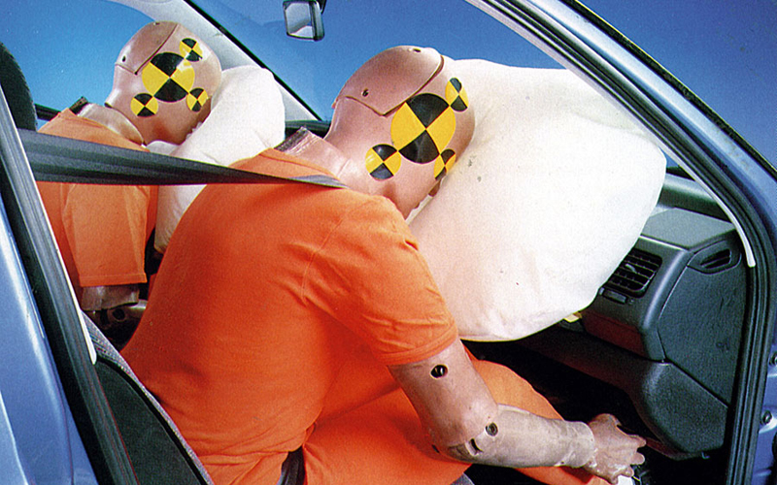
Automotive…
Notes:
Automotive industry was one of the driving forces in the development of small sensors for acceleration (actually deceleration), etc.

Slide 13
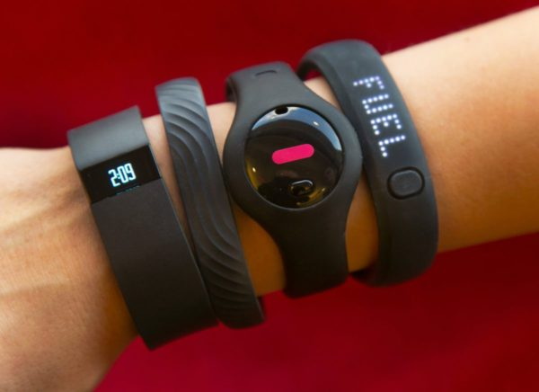
“Quantified self”…
Notes:
FitBits, Fuel Bands, Moov fitness trackers….
Low power, light, cheap, reasonably accurate.
Note the round one… (a moov?) It is a very similar size to the Mbient Labs MetaWear CPRO we’ll come to shortly….

Slide 14
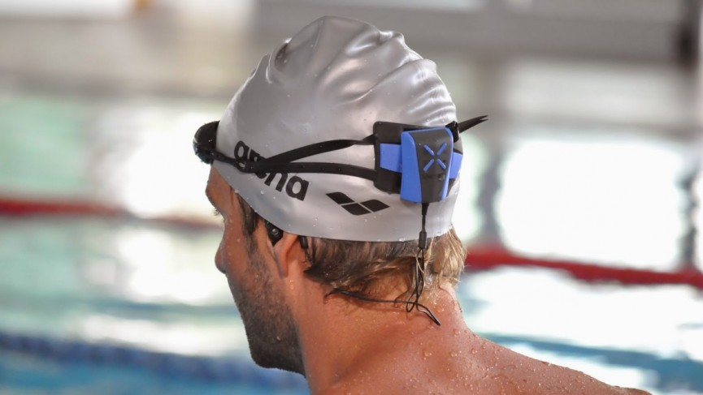
Sports coaching…
Notes:
Of course, serious sports is a big market for wearable sensors.

Slide 15
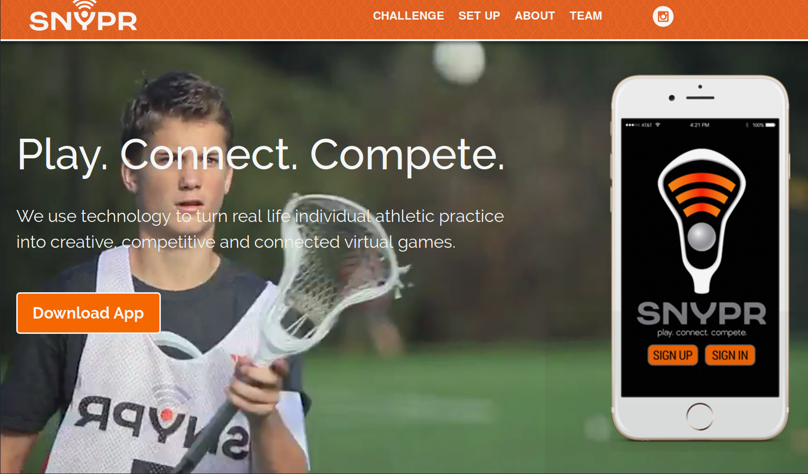
Sports coaching…
Notes:
Snypr – Lacrosse training app …. Slip phone into holder on arm… Detect motion… Analyse….. Count reps….Virtual training

Slide 16

Sports coaching…
Notes:
Zepp … sensors for golf, tennis, baseball, etc.
Green disc fits on the end of the club’s handle.
Apparent coaching includes comparing your swing with a library of swings from professionals.
https://www.wareable.com/golf/zepp-2-offers-new-design-and-enhanced-coaching-2548

Slide 17
Types of sensors
Gyroscope
Angular rotation rate
Accelerometer
Linear acceleration plus gravity
Magnetometer
Local magnetic field
GPS
Absolute location (outdoor)
Pressure
Altitude (outdoor); relative height (indoor)
+ light, sound, touch, temperature, humidity, heart rate, …
Notes:
OK, that was a skim through the applications…. These sensors are now so cheap and small, we will see them everywhere….

Slide 18
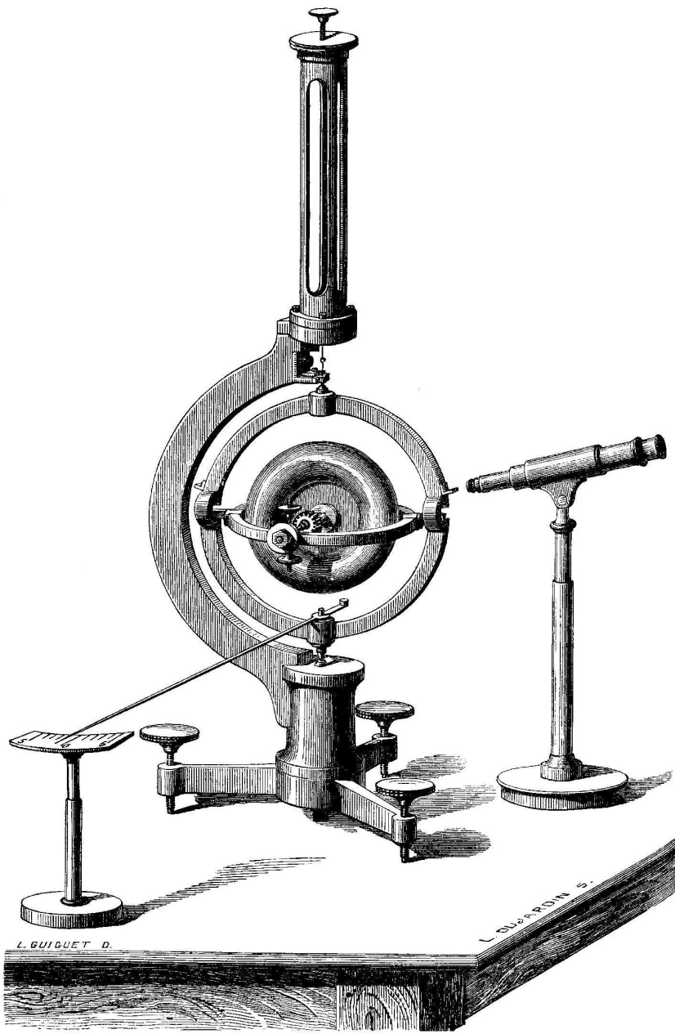
Types of sensors
Gyroscope
Angular rotation rate
Accelerometer
Linear acceleration plus gravity
Magnetometer
Local magnetic field
GPS
Absolute location (outdoor)
Pressure
Altitude (outdoor); relative height (indoor)
+ light, sound, touch, temperature, humidity, heart rate, …
Notes:
First sensor we will look at is a gyroscope., which measures angular rotation rate…
This is from 1852… Leon Foucault…
(next slide)

Slide 19
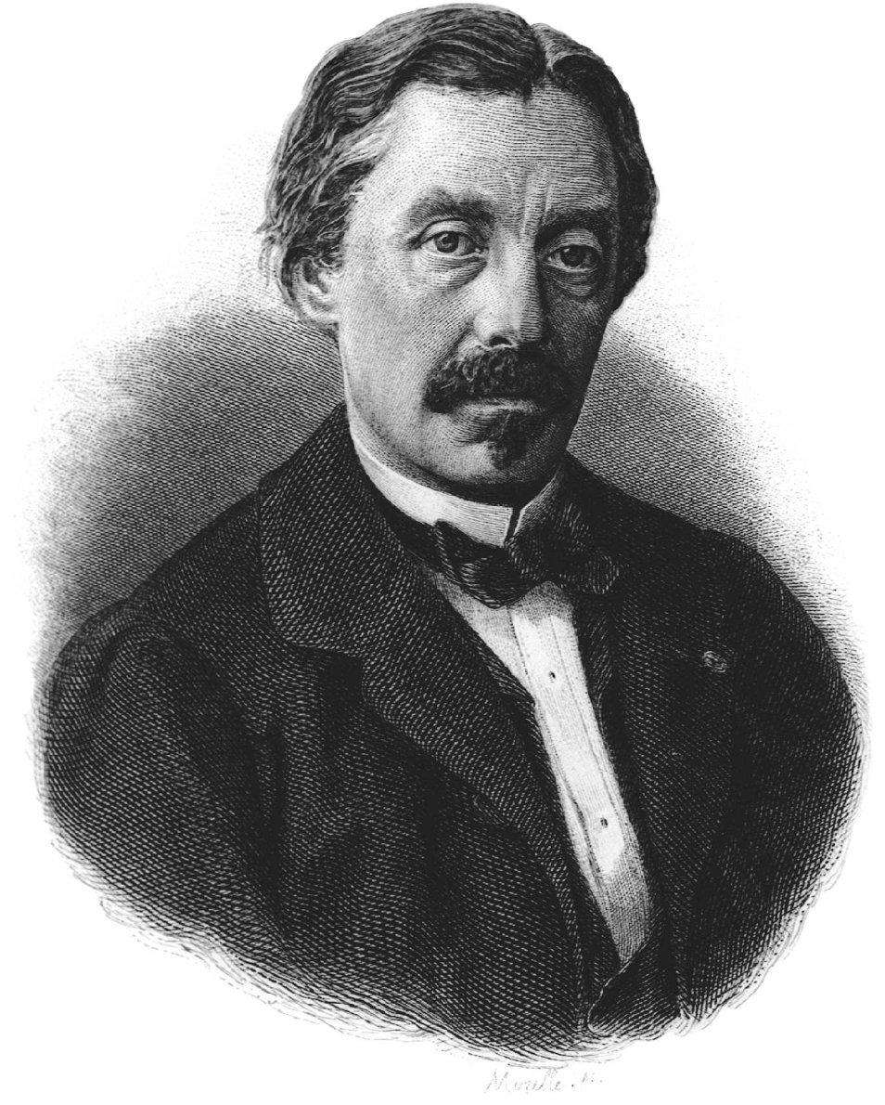
Foucault’s gyroscope (1852)
Notes:
In 1851, Leon Foucault famous pendulum rotated once per sidereal day – 23h56m at the poles.
But as you move down in latitude, the swing plane is at an angle to the rotation of the earth through the poles.
The rotation slowed down depending on the sine of the latitude.
In 1852, he build a gyroscope where the rotating mass maintained a fixed direction as the earth rotated.
It only ran for 10 minutes before slowing. This was enough to prove the principle.
Pictures are from http://tobin.pagesperso-orange.fr/PROBING_SPACE_Nelson.pdf

Slide 20
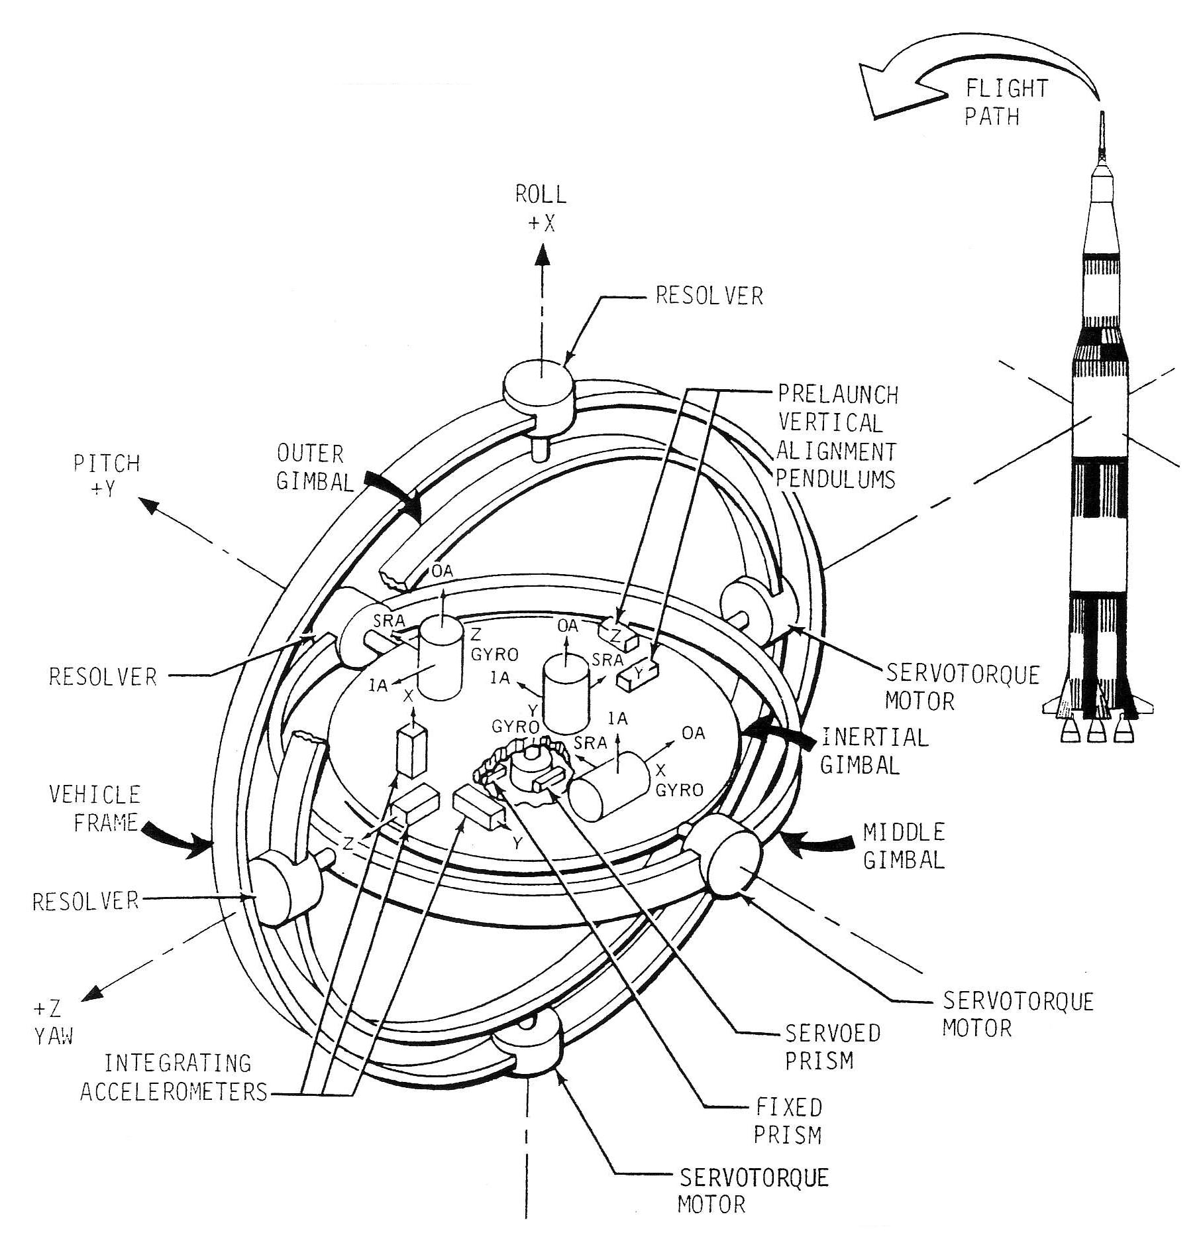
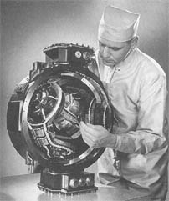
ST124-M inertial platform for Saturn V (1965)
Notes:
ST124-M inertial platform system

Slide 21
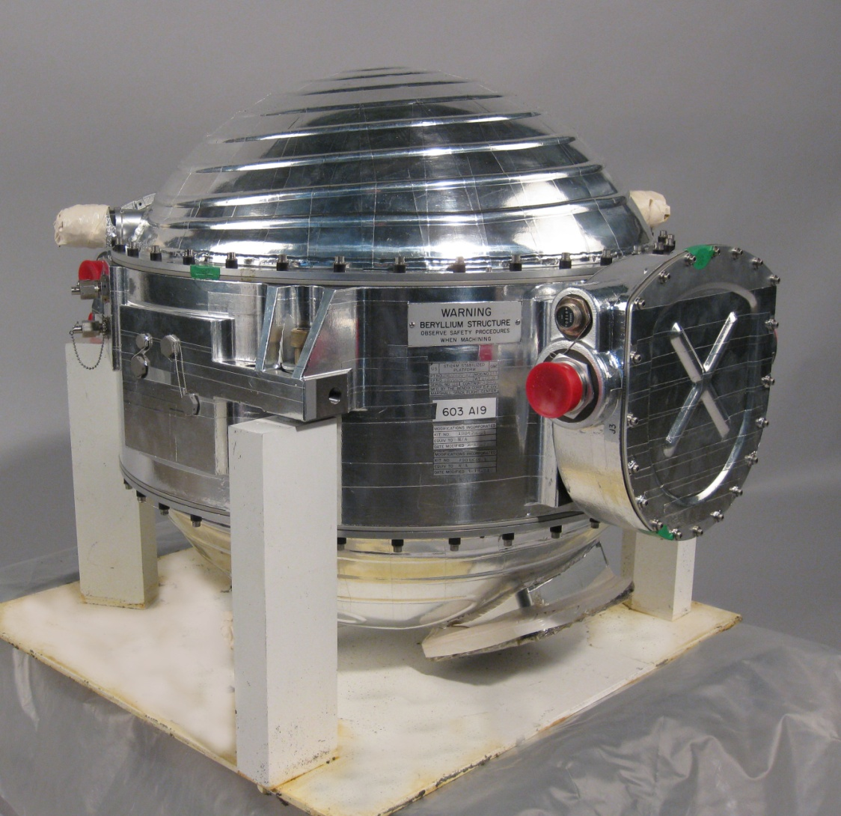

Slide 22
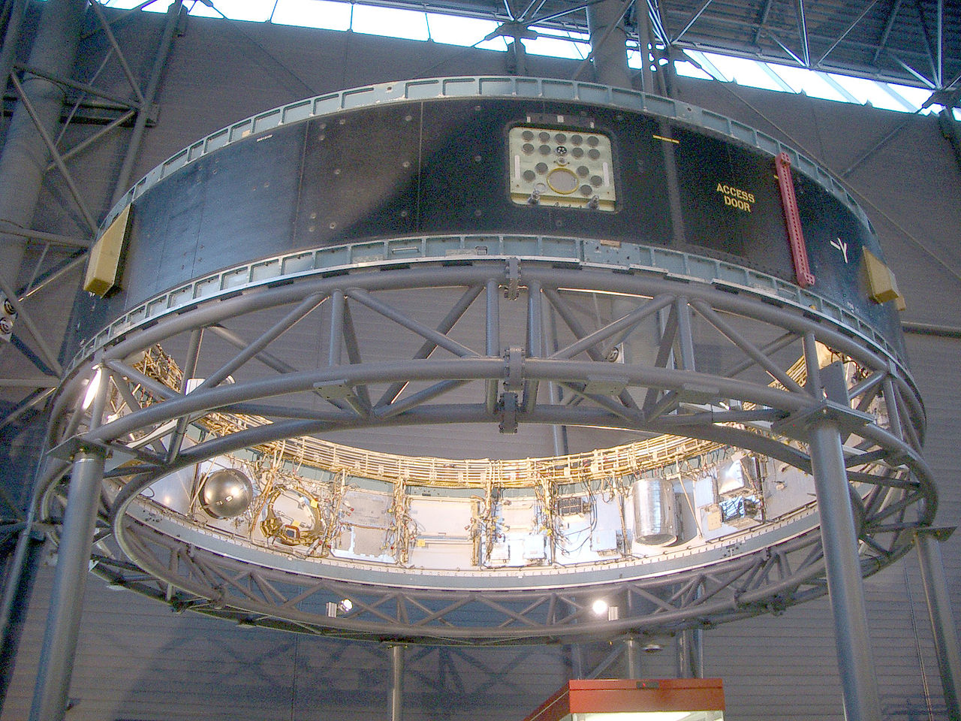
Notes:
IU-514 instrument unit
Silver sphere contains nitrogen for lubricating the gimbals.
Empty spot to the right is where the ST124-M gimbal unit would sit

Slide 23
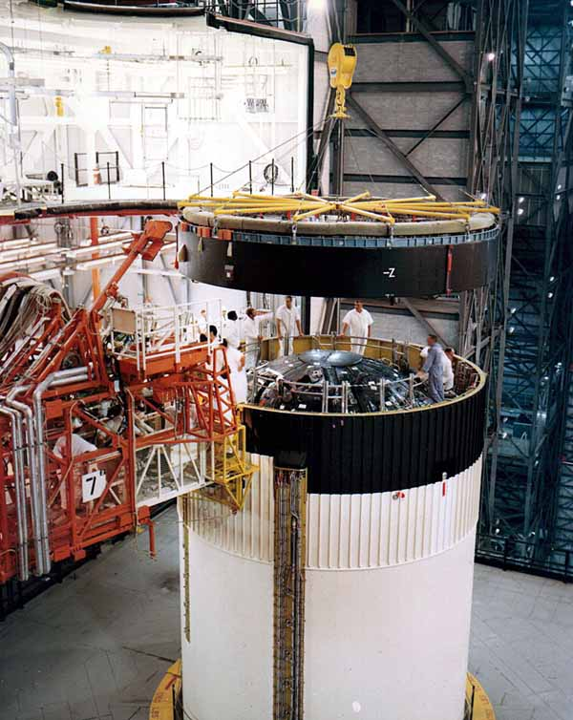

Slide 24
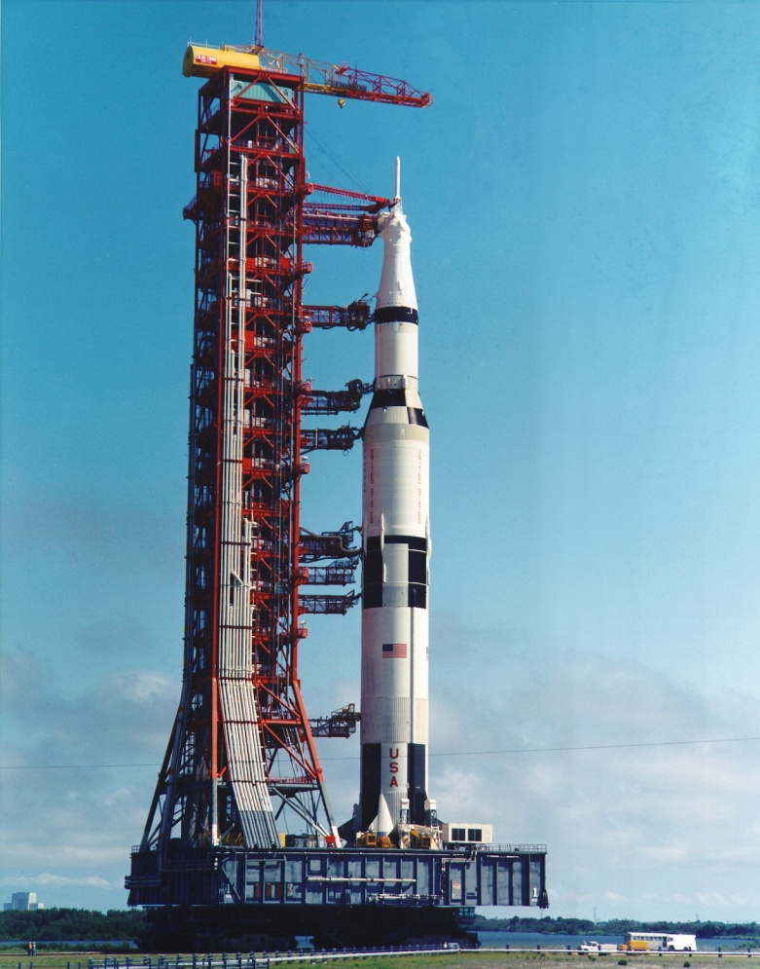

Slide 25
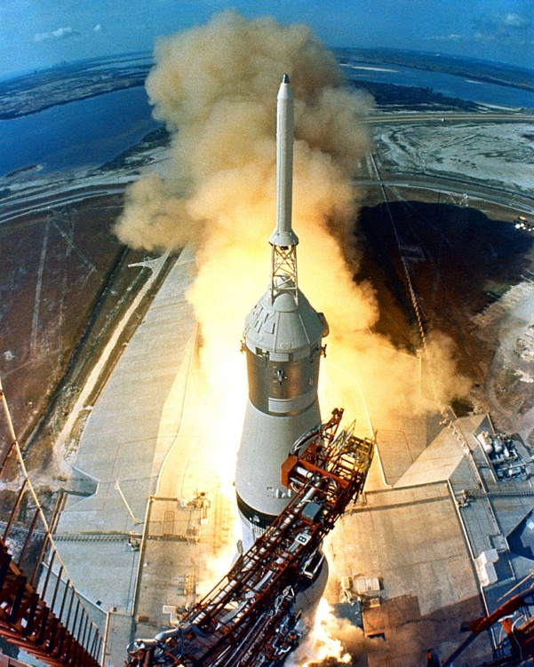

Slide 26
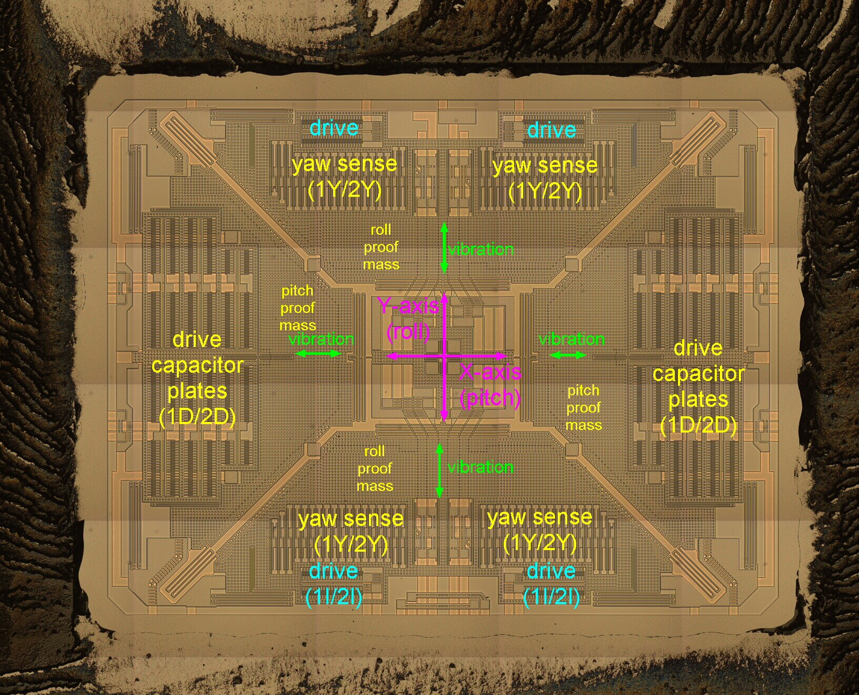
MEMS gyroscope (2016)
Notes:
MEMS = Micromachined electromagnetic structure
This is about 1mm across…. Compared with the sphere in the ST124-M

Slide 27
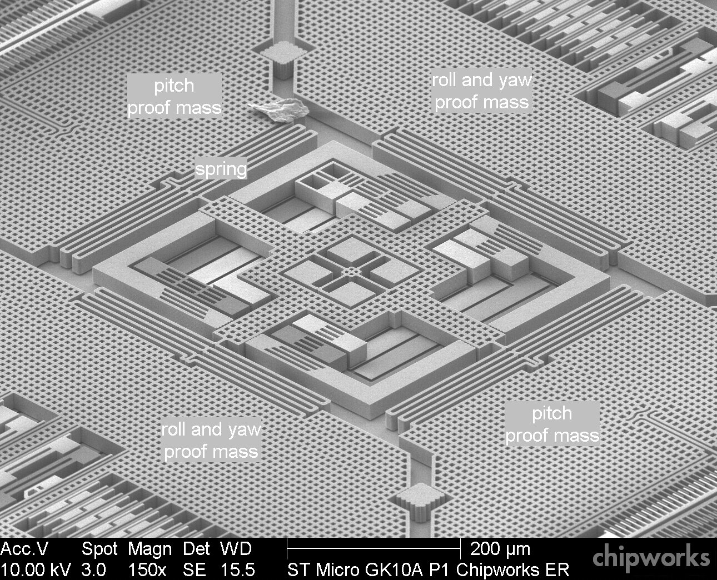
MEMS gyroscope (2016)
Notes:
Image is from:
http://www.memsjournal.com/2011/01/motion-sensing-in-the-iphone-4-mems-gyroscope.html
http://memsjournal.typepad.com/.a/6a00d8345225f869e20148c7d54d63970c-pi

Slide 28
Types of sensors
Gyroscope
Angular rotation rate
Accelerometer
Linear acceleration plus gravity
Magnetometer
Local magnetic field
GPS
Absolute location (outdoor)
Pressure
Altitude (outdoor); relative height (indoor)
+ light, sound, touch, temperature, humidity, heart rate, …
A_{xyz} = A_{sensor} - R g
R is rotation matrix converting gravity vector g to sensor’s local (x,y,z) coordinates
Notes:
See

Slide 29
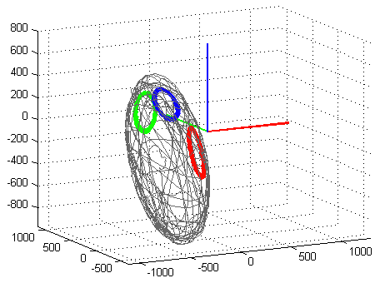
Types of sensors
B_{x,y,z} = W R_{φ} R_{θ} R_{ψ} B_{earth} + V
R_{φ} R_{θ} R_{ψ} rotates the earth’s magnetic field by yaw (ψ), pitch (θ) and roll (φ) angles to the sensor’s local (x,y,z) coordinates
W (3x3 matrix) and V (xyz-vector) are “soft iron” and “hard iron” distortions for ferromagnetic components that move with the sensor
Gyroscope
Angular rotation rate
Accelerometer
Linear acceleration plus gravity
Magnetometer
Local magnetic field
GPS
Absolute location (outdoor)
Pressure
Altitude (outdoor); relative height (indoor)
+ light, sound, touch, temperature, humidity, heart rate, …
Notes:
Picture is from a blog post by Seb Madgwick, who wrote the seminal paper “An efficient orientation filter for inertial and intertial/magnetic sensor arrays” (30 Apr, 2010)
Blog post is: http://diydrones.com/forum/topics/magnetometer-soft-and-hard-iron-calibration

Slide 30
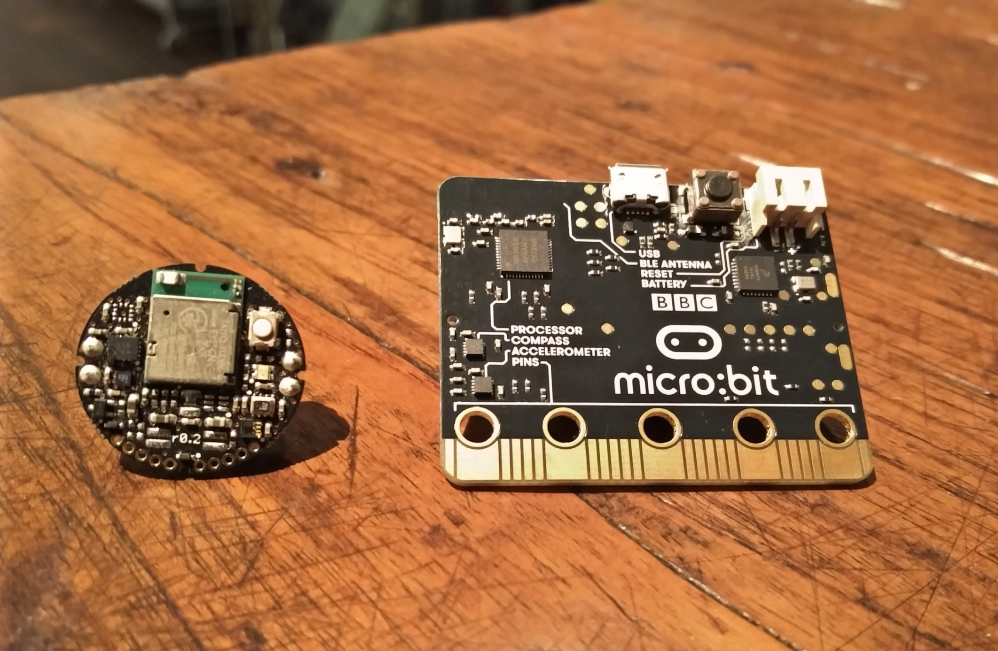
Sensors in Metawear CPRO and BBC micro:bit
Accelerometer
Gyroscope
Magnetometer
Accelerometer Magnetometer
Notes:
MetaWear Pro C from Mbient Labs (24 mm diameter). BBC MicroBit (43x52mm)

Slide 31
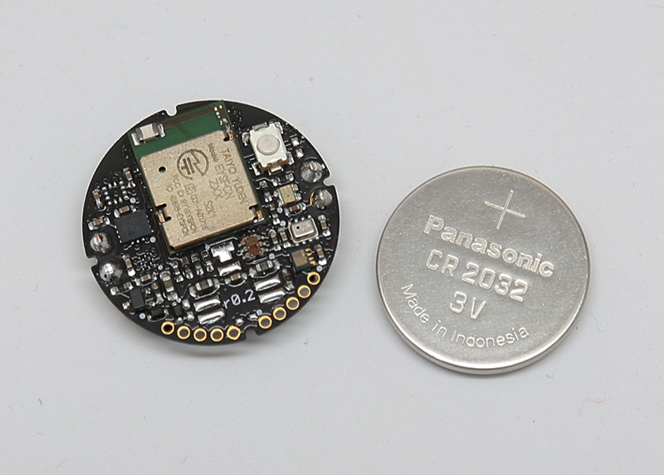
Metaware CPRO – hardware
CPU
nRF51822 - Nordic Semiconductor
ARM Cortex-M0, 32k RAM, 256k flash
Interfaces
Bluetooth LE (stream up to 100 Hz)
Push button; 1 LED
Sensors
BMI160 (Bosch)
Accelerometer - 3 axis, 14-bit, up to 800Hz
Gyroscope – 3 axis, 16 bit
BMI155 Magnetometer (Bosch)
3 axis, 16-bit, up to 80 Hz
±1300µT (sens 0.3µT)
Pressure: 300-1100 hPa
Temperature: -40 to 85 °C
Light: 0.01 to 64k lux
PCB: 24 mm diameter
sensors: 2 x 2 mm

Slide 32
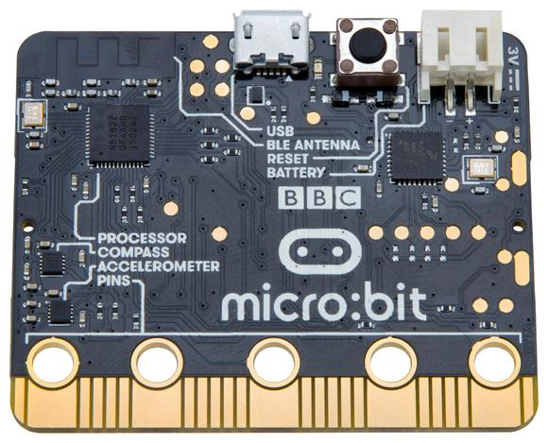
BBC microbit – hardware
CPU
nRF51822 - Nordic Semiconductor
ARM Cortex-M0, 16k RAM, 256k flash
Interfaces
Bluetooth LE; radio; USB Push buttons
Sensors
Accelerometer MMA8652FC (NXP)
3 axis, 12-bit, up to 800Hz
6-180µA @ 2.4V
±2/4/8g (sens ±2.5%, offset ±33mg, noise 182µg/√Hz)
Magnetometer MAG3110 (NXP)
3 axis, 16-bit, up to 80 Hz
9-900µA @ 2.4V
±1000µT (sens 0.1µT, noise 0.25µT)
PCB: 43 x 52 mm
sensors: 2 x 2 mm

Slide 33
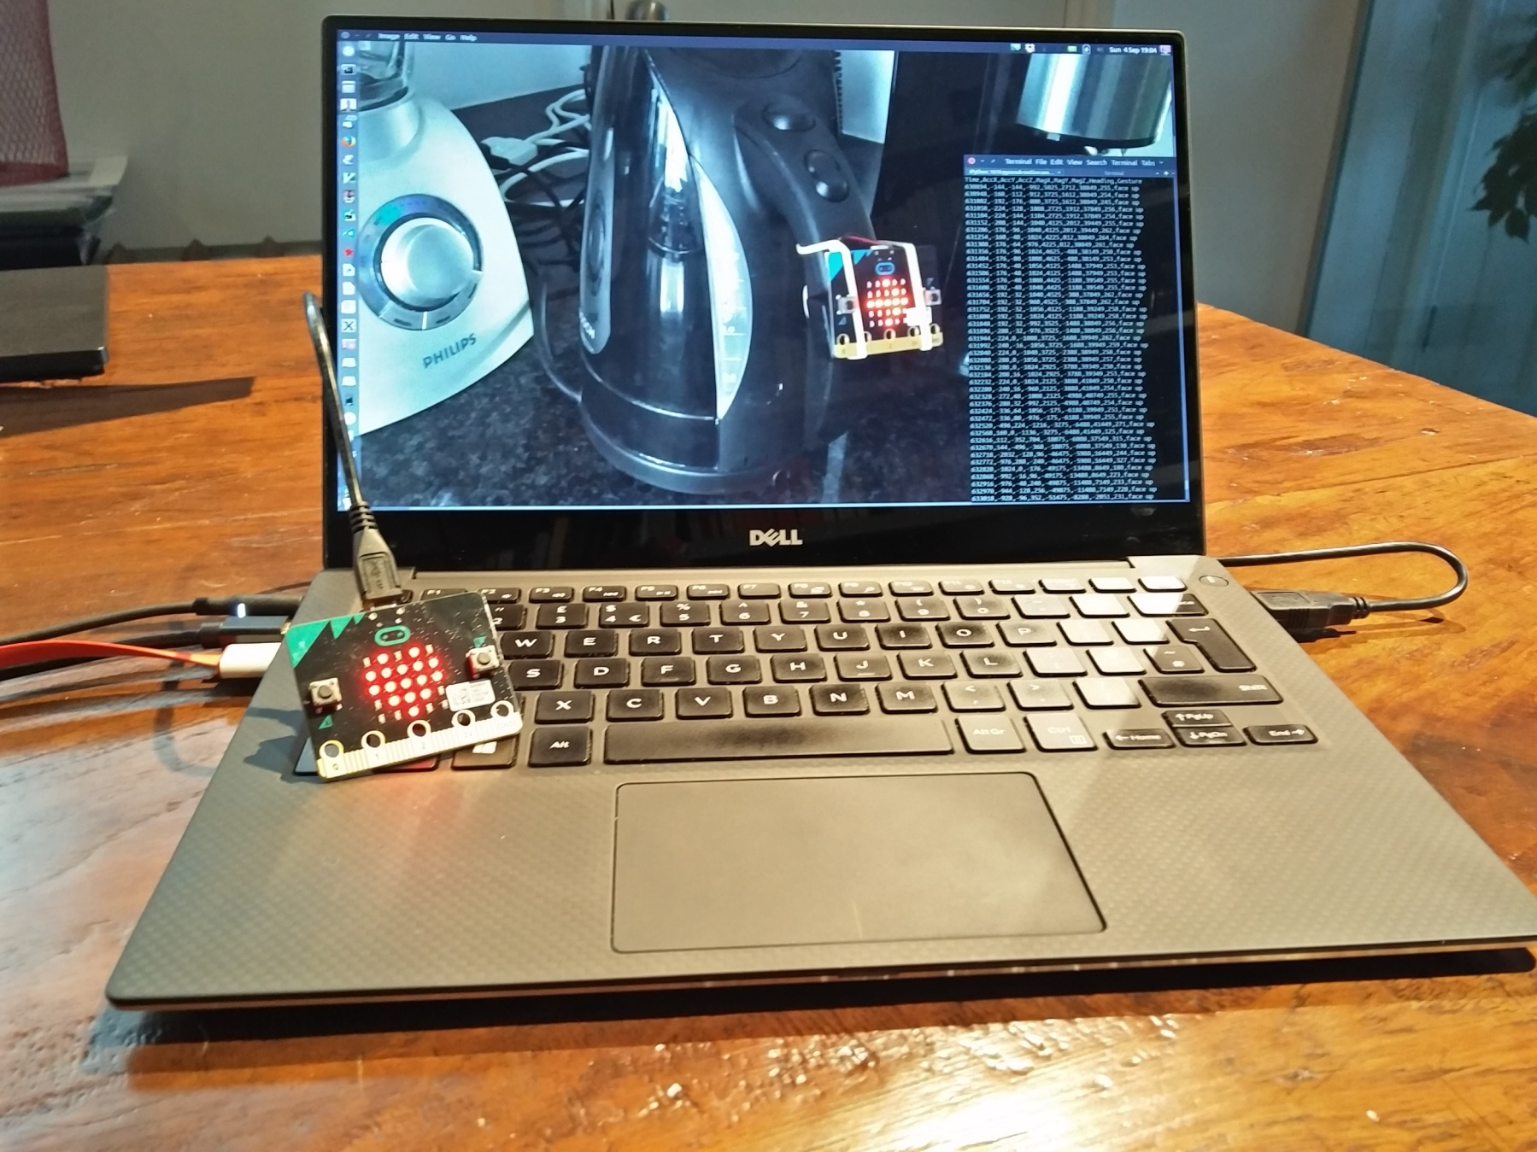
Example #1 – Wireless motion logging

Slide 34
Example #1 – BBC microbit code
# Transmit sensor data via radio
from microbit import *
import radio
header = "Time,AccX,AccY,AccZ,MagX,MagY,MagZ,Heading,Gesture\n“
def read_sensors():
"Sensor data as a comma-separated string with a newline"
t = running_time()
ax, ay, az = accelerometer.get_values()
g = accelerometer.current_gesture()
cx, cy, cz = compass.get_x(), compass.get_y(), compass.get_z()
h = compass.heading()
msg = '%d,%d,%d,%d,%d,%d,%d,%d,%s\n' % (t,ax,ay,az,cx,cy,cz,h,g)
return msg

Slide 35
Example #1 – BBC microbit code
# Transmit sensor data via radio
from microbit import *
import radio
header = "Time,AccX,AccY,AccZ,MagX,MagY,MagZ,Heading,Gesture\n“
def read_sensors():
"Sensor data as a comma-separated string with a newline"
t = running_time()
ax, ay, az = accelerometer.get_values()
g = accelerometer.current_gesture()
cx, cy, cz = compass.get_x(), compass.get_y(), compass.get_z()
h = compass.heading()
msg = '%d,%d,%d,%d,%d,%d,%d,%d,%s\n' % (t,ax,ay,az,cx,cy,cz,h,g)
return msg
radio.config(length=100)
radio.on()
radio.send(header)
while True:
data = read_sensors()
radio.send(data)
sleep(25)

Slide 36
Example #1 – BBC microbit code
# Transmit sensor data via radio
from microbit import *
import radio
header = "Time,AccX,AccY,AccZ,MagX,MagY,MagZ,Heading,Gesture\n“
def read_sensors():
"Sensor data as a comma-separated string with a newline"
t = running_time()
ax, ay, az = accelerometer.get_values()
g = accelerometer.current_gesture()
cx, cy, cz = compass.get_x(), compass.get_y(), compass.get_z()
h = compass.heading()
msg = '%d,%d,%d,%d,%d,%d,%d,%d,%s\n' % (t,ax,ay,az,cx,cy,cz,h,g)
return msg
radio.config(length=100)
radio.on()
radio.send(header)
while True:
data = read_sensors()
radio.send(data)
sleep(25)
# Relay radio data to host PC via USB
from microbit import *
import radio
radio.config(length=100)
radio.on()
uart.init(115000)
while True:
data = radio.receive()
if data:
uart.write(data)

Slide 37
Example #1 – Analyse data in IPython
# See Jupyter notebook analysis-kettle.ipynb
%matplotlib inline
import matplotlib
import pandas as pd
>>> df = pd.read_csv('data.csv')
>>> df['Time'] /= 1000.0 # ms to sec
>>> df.set_index('Time', inplace=True)
>>> df.info()
<class 'pandas.core.frame.DataFrame'>
Float64Index: 5860 entries, 12.9 to 246.1
Data columns (total 8 columns):
AccX 5860 non-null int64
AccY 5860 non-null int64
AccZ 5860 non-null int64
MagX 5860 non-null int64
MagY 5860 non-null int64
MagZ 5860 non-null int64
Heading 5860 non-null int64
Gesture 3760 non-null object
dtypes: int64(7), object(1)
memory usage: 412.0+ KB

Slide 38
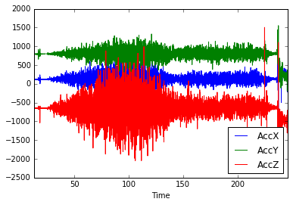
Example #1 – Analyse data in IPython
# See Jupyter notebook analysis-kettle.ipynb
%matplotlib inline
import matplotlib
import pandas as pd
>>> df = pd.read_csv('data.csv')
>>> df['Time'] /= 1000.0 # ms to sec
>>> df.set_index('Time', inplace=True)
>>> df.info()
>>> accXYZ = df[['AccX','AccY','AccZ']]
>>> accXYZ.plot()
heating
simmering
boiling

Slide 39
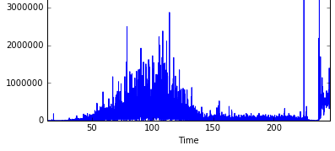
Example #1 – Analyse data in IPython
# See Jupyter notebook analysis-kettle.ipynb
%matplotlib inline
import matplotlib
import pandas as pd
>>> df = pd.read_csv('data.csv')
>>> df['Time'] /= 1000.0 # ms to sec
>>> df.set_index('Time', inplace=True)
>>> df.info()
>>> accXYZ = df[['AccX','AccY','AccZ']]
>>> accXYZ.plot()
>>> g = accXYZ[50.0:200.0].mean()
>>> g
AccX 128.733753
AccY 802.477987
AccZ -636.926625
dtype: float64
>>> s = (accXYZ - g).pow(2).sum(axis=1)
>>> s.plot()
heating
simmering
boiling

Slide 40
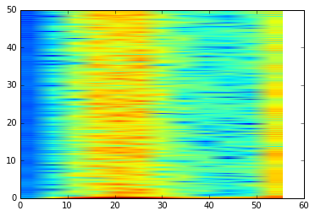
Example #1 – Analyse data in IPython
# See Jupyter notebook analysis-kettle.ipynb
%matplotlib inline
import matplotlib
import pandas as pd
>>> df = pd.read_csv('data.csv')
>>> df['Time'] /= 1000.0 # ms to sec
>>> df.set_index('Time', inplace=True)
>>> df.info()
>>> accXYZ = df[['AccX','AccY','AccZ']]
>>> accXYZ.plot()
>>> g = accXYZ[50.0:200.0].mean()
>>> g
AccX 128.733753
AccY 802.477987
AccZ -636.926625
dtype: float64
>>> s = (accXYZ - g).pow(2).sum(axis=1)
>>> s.plot()
>>> import matplotlib.pyplot as plt
>>> plt.specgram(s, NFFT=512, Fs=100, noverlap=32)[3]
heating
simmering
boiling

Slide 41
Project ideas
Sports stats
Log accelerometer data while repeated a sport-related action (running, hitting tennis ball, …)
Plot the time series
Identify characteristic motion
Find decision rules to pinpoint time when motion occurred
Use decision rule to total sports stats (# actions, speed etc)
Orientation
Read accelerometer data
Figure out which simple gesture fits best (“falling”, “left”, “up”…)
Display first letter of the active gesture on the screen

Slide 42
Data fusion algorithms
Combine data from multiple sensors
Reduce position errors when integrating accel/vel
Correct for sensor bias, drift, noise, nonlinearities
Deal with missing data points
Accelerometer
Magnetometer
Tilt-compensated electronic compass
(if acceleration = 0)
Accelerometer
Gyroscope
Inertial Measurement Unit (IMU)
(6 DoF – orientation, no absolute yaw)
Accelerometer
Magnetometer
Gyroscope
Attitude Heading Reference System (AHRS)
Magnetic, Angular Rate, Gravity (MARG)
(9 DoF – orientation, absolute north)
Notes:
Position errors proportional to t^3

Slide 43
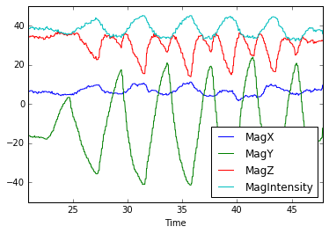
Example #2 – Tilt-compensating compass
Raw magnetometer data
# See analysis-tilt-compensation.ipynb
import numpy as np
import pandas as pd
import math
rad2deg = 180.0 / math.pi
# Data is collected via microbit data logger as the
# microbit is tilted up and down while pointed in
# approximately a constant heading.
df = pd.read_csv('data-compass-heading-with-tilt.csv')
df['Time'] /= 1000.0 # ms (int) to sec (float)
df.set_index('Time', inplace=True)
def magXYZ_plus_intensity(df):
'''Add column 'MagIntensity' to DataFrame df'''
m = df[['MagX','MagY','MagZ']].copy()
m['MagIntensity'] = m.pow(2).sum(axis=1).pow(0.5)
return m
magXYZ_plus_intensity(df).plot()

Slide 44
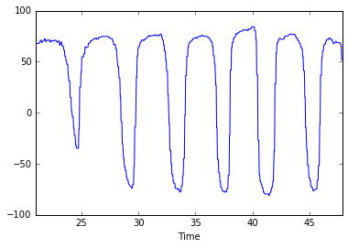
Example #2 – Tilt-compensating compass
Raw magnetometer data
# See analysis-tilt-compensation.ipynb
import numpy as np
import pandas as pd
import math
rad2deg = 180.0 / math.pi
# Data is collected via microbit data logger as the
# microbit is tilted up and down while pointed in
# approximately a constant heading.
df = pd.read_csv('data-compass-heading-with-tilt.csv')
df['Time'] /= 1000.0 # ms (int) to sec (float)
df.set_index('Time', inplace=True)
def magXYZ_plus_intensity(df):
'''Add column 'MagIntensity' to DataFrame df'''
m = df[['MagX','MagY','MagZ']].copy()
m['MagIntensity'] = m.pow(2).sum(axis=1).pow(0.5)
return m
magXYZ_plus_intensity(df).plot()
# Simple compass heading (yaw angle = psi)
psi = rad2deg * np.arctan2(-df.MagY, df.MagX)
s = pd.Series(psi, index=df.index)
s.plot()
Calculated heading (degrees)

Slide 45
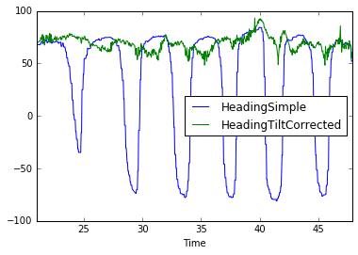
Example #2 – Tilt-compensating compass
def compass_heading_tilt_comp(df):
"""Pandas Series with heading corrected for tilt.
This assumes the accelerometer is held still.
From the angle of gravity, infer the magnetometer's
tilt relative to the Earth's surface.
Undo the effects of tilt in the roll and pitch
directions, leaving a clean magnetic heading in
the yaw (Z) direction.
The input dataframe is assumed to have columns named
MagX, MagY, MagZ, AccX, AccY, AccZ.
"""
ax, ay, az = df.AccX, df.AccY, df.AccZ
mx, my, mz = df.MagX, df.MagY, df.MagZ
# Undo roll around X axis by angle phi
phi = np.arctan2(ay, az) # +/- 180 degrees
s, c = np.sin(phi), np.cos(phi)
az = ay*s + az*c
my, mz = (my*c - mz*s), (my*s + mz*c)
# Undo pitch around Y axis by angle theta
theta = np.arctan(-ax / az) # +/-90 degrees
s, c = np.sin(theta), np.cos(theta)
mx, mz = (mx*c + mz*s), (-mx*s + mz*c)
# Calculate yaw angle psi around Z axis
psi = np.arctan2(my, mx)
s = pd.Series(psi*rad2deg, index=df.index,
name='HeadingTiltCorrected')
return s
Raw magnetometer data
Calculated heading (degrees)

Slide 46
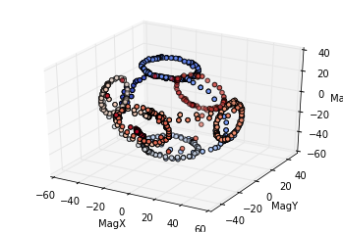
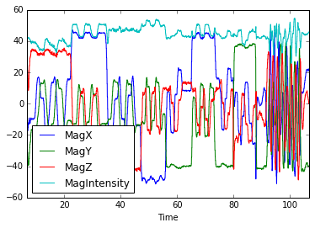
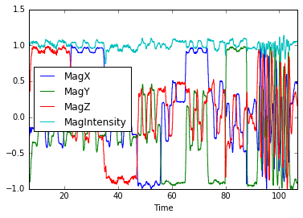
Example #2 – Simple magnetometer calibration
B_{x,y,z} = W R_{φ} R_{θ} R_{ψ} B_{earth} + V where V = “hard iron”; W = “soft iron”
Ideal readings lie on a perfect sphere
Pre- and post- calibration data
Proper calibration fits W to an ellipsoid.
To simplify the example today, don’t worry about rotation, just offset V and scale S:
V = (magXYZ.min() + magXYZ.max()) / 2
S = (magXYZ.max() - magXYZ.min()) / 2
magXYZ_cal = (magXYZ – V) / S

Slide 47
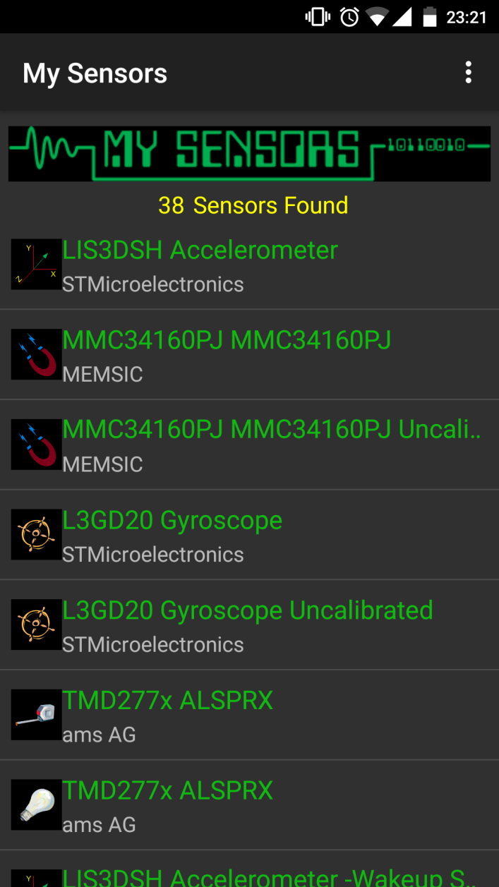
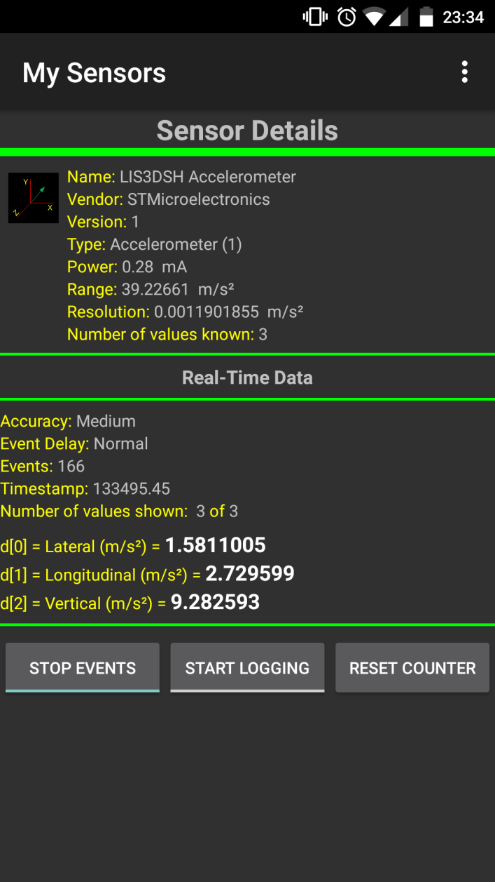
Example #3 – Mobile phone sensor data
List sensors, manufacturers, specs, etc
My Sensors
Stream sensor data over wifi
IMU+GPS-Stream
Log sensor data to csv on phone
Physics Toolbox Suite
Or write your own app for processing sensor data locally

Slide 48
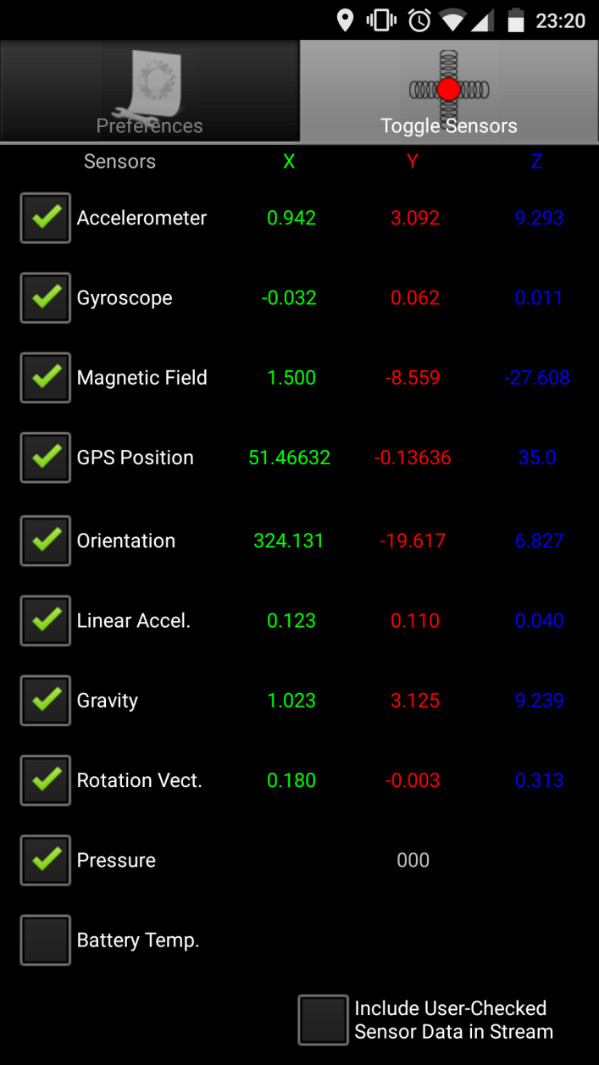
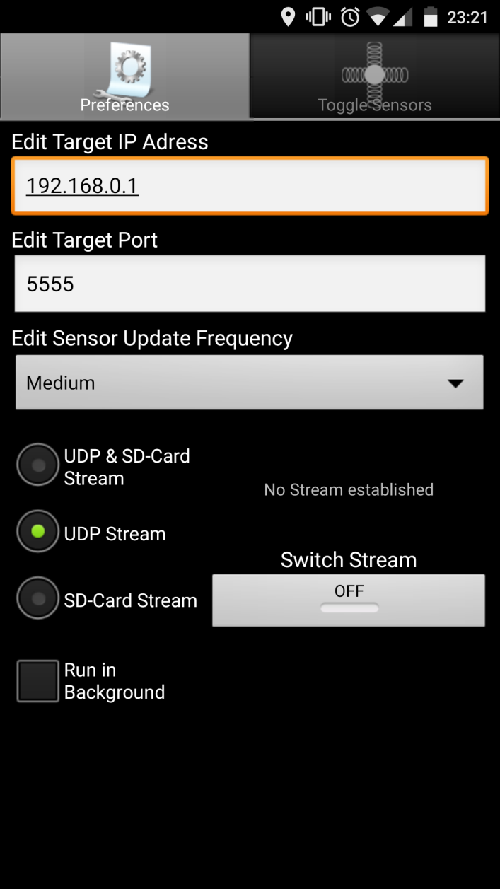
Example #3 – Mobile phone sensor data
List sensors, manufacturers, etc
My Sensors
Stream sensor data over wifi
IMU+GPS-Stream
Log sensor data to csv on phone
Physics Toolbox Suite
Or write your own app for processing sensor data locally

Slide 49
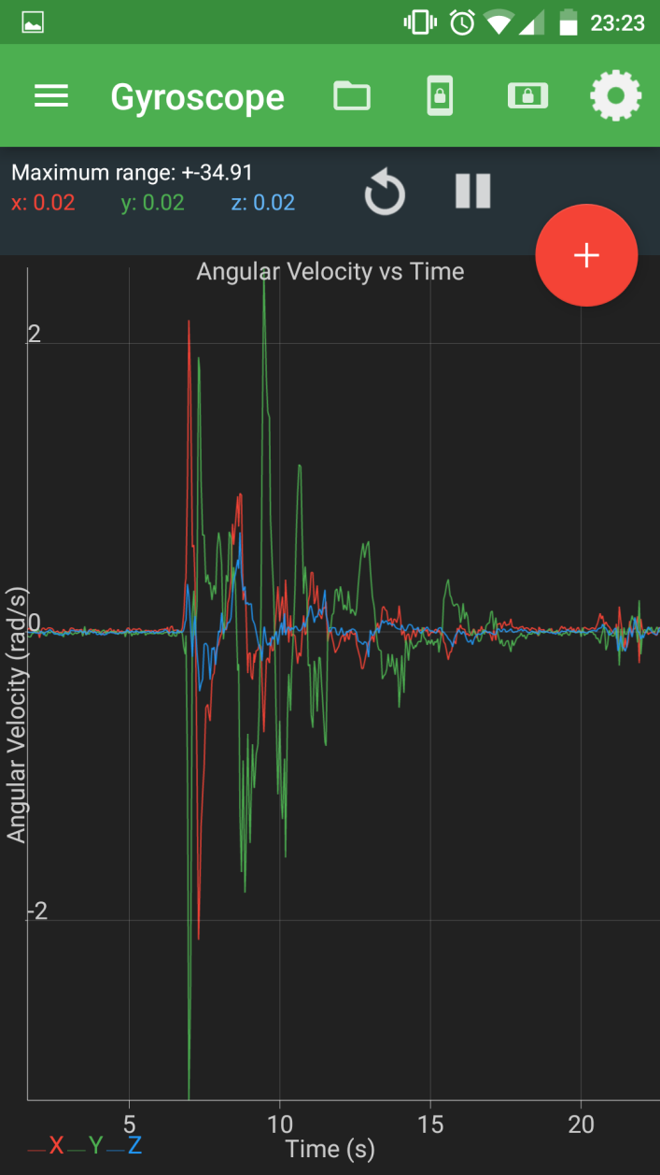
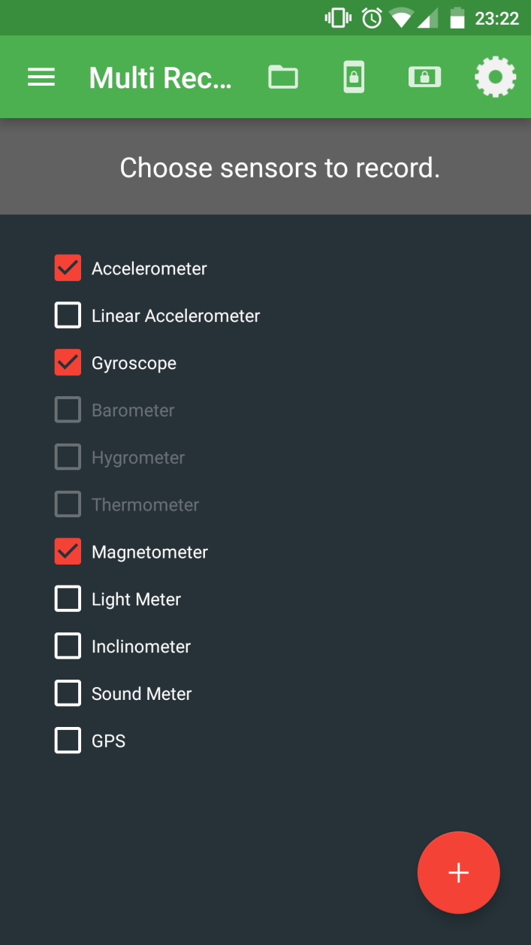
Example #3 – Mobile phone sensor data
List sensors, manufacturers, etc
My Sensors
Stream sensor data over wifi
IMU+GPS-Stream
Log sensor data to csv on phone
Physics Toolbox Suite
Or write your own app for processing sensor data locally

Slide 50
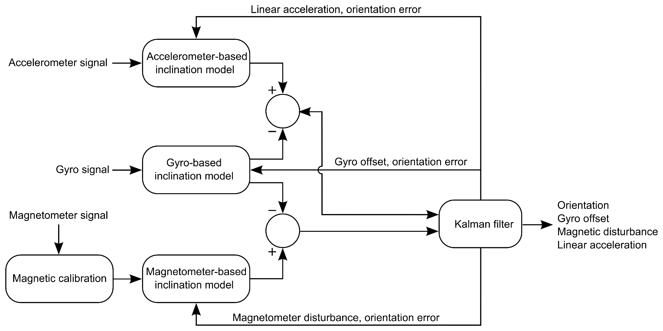
Example #3 – Kalman filter for 9-DoF IMU
Diagram from NXP Sensor Fusion Library for Kinetis MCUs, release 7.00, August 2016

Slide 51
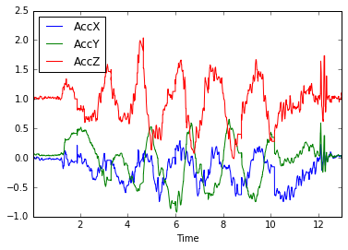
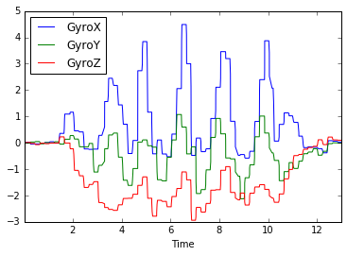
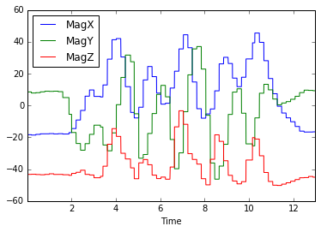
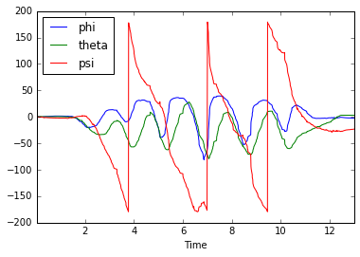
Example #3 – Kalman filter for 9-DoF IMU
# Load 9-DoF sensor data as pandas DataFrame
df = pd.read_csv("data-IMU.csv")
names = 'Time,AccX,AccY,AccZ,GyroX,GyroY,GyroZ,MagX,MagY,MagZ'.split(',')
df.rename(columns=dict(zip(df.columns, new_names)), inplace=True)
df.set_index('Time', drop=False, inplace=True)
# Get data as numpy arrays that scikit-kinematics expects
aXYZ = df[['AccX','AccY','AccZ']].values
gXYZ = df[['GyroX','GyroY','GyroZ']].values
mXYZ = df[['MagX','MagY','MagZ']].values
# IMU using Kalman filter from scikit-kinematics
# http://work.thaslwanter.at/skinematics/html/index.html
rate = len(df) / (df.Time.max() - df.Time.min())
import skinematics as skin
quaternion_arr = skin.imus.kalman_quat(rate, aXYZ*9.81, gXYZ, mXYZ)
quaternion_obj = skin.imus.quat.Quaternion(quaternion_arr)
angles_arr = quaternion_obj.export('Fick') * 180/math.pi
angles_df = pd.DataFrame(angles_arr, columns=['phi', 'theta','psi'], index=df.index)
angles_df.plot()

Slide 52
Project ideas
Sports stats
Log accelerometer data while repeated a sport-related action (running, hitting tennis ball, …)
Plot the time series
Identify characteristic motion
Find decision rules to pinpoint time when motion occurred
Use decision rule to total sports stats (# actions, speed etc)
Orientation
Read accelerometer data
Figure out which simple gesture fits best (“falling”, “left”, “up”…)
Display first letter of the active gesture on the screen
9 DoF IMU (Inertial Measurement Unit)
Find a Python IMU project on GitHub
Capture accel/mag/gyro data from mobile phone
Reformat the data and feed into the IMU
See how accurately this can track orientation/position using a Kalman filter

Slide 53
References
Github report accompanying this talk
http://github.com/stevesimmons/pyconuk-motion-sensor-data-fusion
BBC micro:bit (has accelerometer and magnetomer, no gyroscope)
MicroPython http://microbit-micropython.readthedocs.io
Mu editor / uFlash https://github.com/ntoll/mu http://uflash.readthedocs.org
MMA8652 accelerometer http://www.nxp.com/files/sensors/doc/data_sheet/MMA8652FC.pdf
MAG3110 magnetometer http://www.nxp.com/files/sensors/doc/data_sheet/MAG3110.pdf
http://www.nxp.com/files/sensors/doc/data_sheet/AN4083.pdf
Data fusion concepts
NXP sensor fusion toolbox (version 7.00, 18 August 2016)
http://www.nxp.com/products/sensors/nxp-sensor-fusion:XTRSICSNSTLBOX?tid=vansensorfusion
Datasheet http://cache.nxp.com/files/sensors/doc/data_sheet/XSFLK_DS.pdf
User guide http://cache.nxp.com/files/sensors/doc/user_guide/NSFK_Prod_UG.pdf
Electronic compass projects (accelerometer and magnetometer)
Circuit Cellar (2012) http://cache.nxp.com/files/sensors/doc/reports_presentations/ARTICLE_REPRINT.pdf
IMU/AHRS projects (accelerometer, gyroscope, magnetometer)
scikit-kinematics http://work.thaslwanter.at/skinematics/html/index.html
Madgwick’s algorithm (2010) https://www.samba.org/tridge/UAV/madgwick_internal_report.pdf
IMU Data Fusing http://www.olliw.eu/2013/imu-data-fusing/
9DoF Sensor Fusion https://github.com/kriswiner/MPU-6050/wiki/Affordable-9-DoF-Sensor-Fusion
Experimental Comparison of Sensor Fusion Algorithms for Attitude Estimation (A Cavallo et al IFAC 2014) http://www.nt.ntnu.no/users/skoge/prost/proceedings/ifac2014/media/files/1173.pdf
BerryIMU http://ozzmaker.com/berryimu-quick-start-guide https://github.com/mwilliams03/BerryIMU
MicroPython 6/9-DOF fusion (needs gyro -> not for BBC micro:bit) https://github.com/micropython-IMU/micropython-fusion

Slide 54
Python, Motion Sensors and Data Fusion PyCon UK, 15 September 2016
Stephen Simmons
mail@stevesimmons.com
https://github.com/stevesimmons/pyconuk-motion-sensor-data-fusion

